Slide 1
Getting a Quick Fix on Comonads
Kenneth Foner
September 3, 2015
Notes:
Good afternoon!
Instead of giving a talk about comonads, I think I’m going to do something isomorphic: give a co-talk about monads … So I think that means that *you* explain monads to *me*!
You look like you know what a monad is, Richard—care to explain it to me?
(monoid in the category of endofunctors)
Exactly! Thank you all for your time and attention. Any questions?
(laughter)
Well, maybe there’s still more to say about comonads than I can *CO*-say about monads.

Slide 2
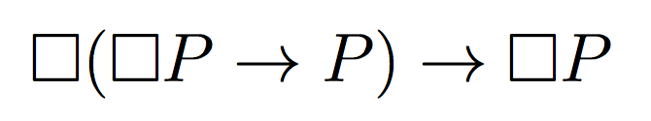
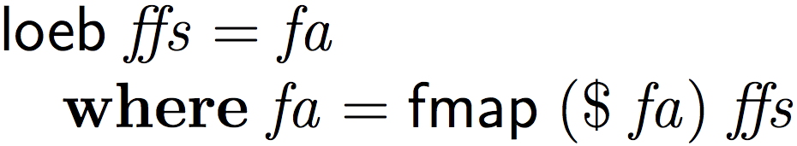
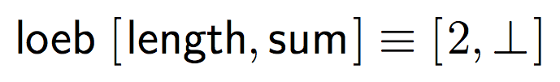




The trailhead: Löb’s theorem
Piponi: “From Löb’s Theorem to Spreadsheet Evaluation”
Notes:
A few years ago…
A funky kind of fixed point in modal provability logic
A funky kind of fixed point in Haskell
To stay inside ASCII, he spells it L-O-E-B, so we’ll stick to that
Picks Functor somewhat arbitrarily
Knot tying is hard!
Explain (STEP BY STEP) with lists…
2, 2 + … coming up

Slide 3
The map: where we’re going
An alternate interpretation of Löb’s theorem into Haskell: more efficient & closer match to the theorem
Inductive definitions to evaluate the new fixed point on n-dimensional structures
A elegant, efficient EDSL for infinite multi-dimensional recurrences
Computing concisely with comonads!

Slide 4
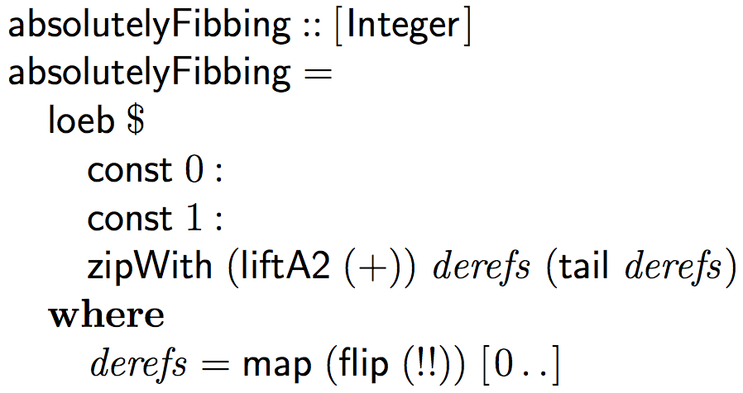
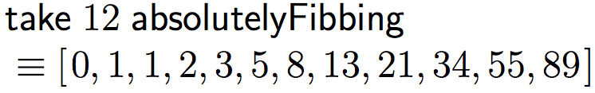
Relativism in an absolute world
Notes:
There are a lot of interesting recurrences we might want to represent with this fixed point.
For instance, we can generate the Fibonacci sequence… (explain)
Your favorite spreadsheet program
(for example Lotus 123)
thinks in terms of absolute references …
But things like Fibonacci…
But here we have to use absolute references to “fake” relative references (explain)
We’re suffering from a disease Richard Bird calls INDEXITIS.

Slide 5
O( no!! )
More generally:
We accidentally an extra factor of O(n)!
2. Encoding relative references in terms of absolute references is clunky.
1. Relative references pay O(n) tax for every “dimension” of the functor.
Notes:
Some symptoms of indexitis include acute asymptotic inefficiency.

Slide 6
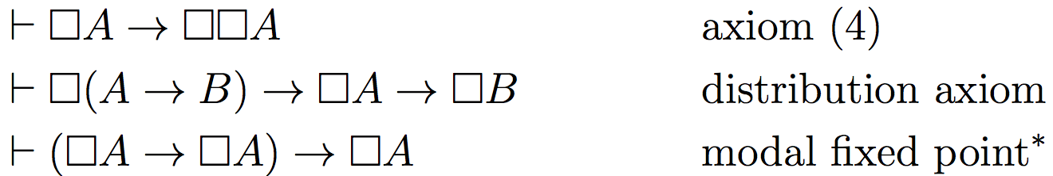
If you can’t fib, play by the rules.
…What are the rules, anyhow?
Löb’s theorem: provable in K4 + modal fixed points.
Proof requires:
K4
Notes:
In the hopes of finding a way to fix this, let’s take a closer look at the axioms in the logical world where we can prove Löb’s theorem.

Slide 7
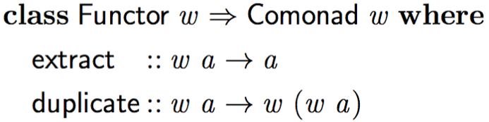

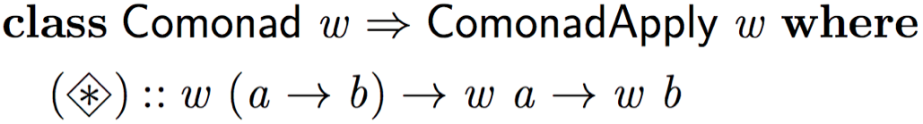

What Haskell structures are shaped like K4’s axioms?
(specialized type)
can simulate modal fixed points (details in the paper)
Notes:
The laws work out nicely.

Slide 8
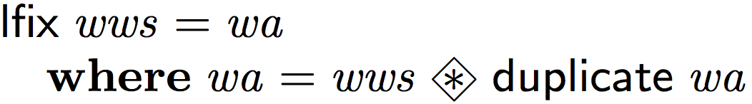
Assembling the puzzle
Pointlessly!
Notes:
DON’T STEP THROUGH THiS
“type tetris”

Slide 9
But what is a comonad(apply)?

Slide 10
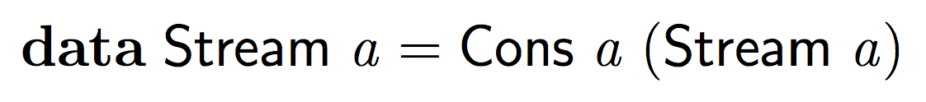
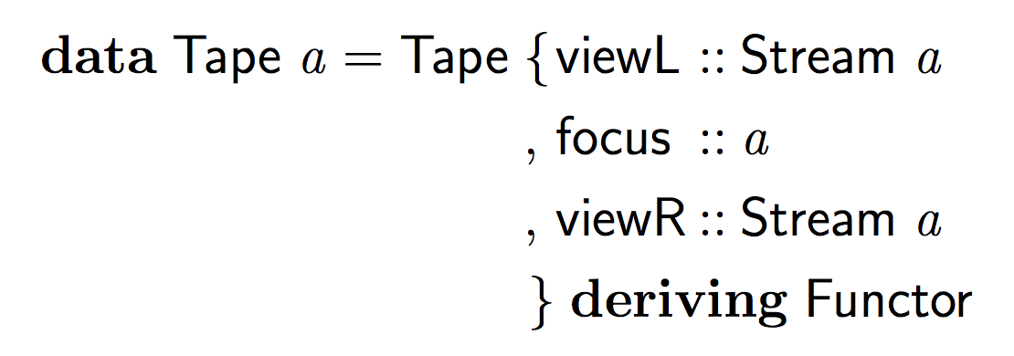



Example: Tape for the ☐
…
…
-3
-2
-1
0
1
2
3
Notes:
The best way to get an intuition for comonad and comonadapply is to build a concrete example.
Let’s make a comonad!
- infinite-both-ways streams (stream zippers) = Tape
* Every zipper induces a comonad.

Slide 11

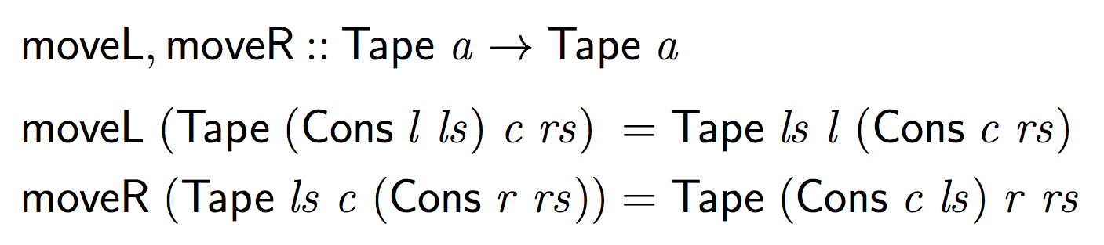
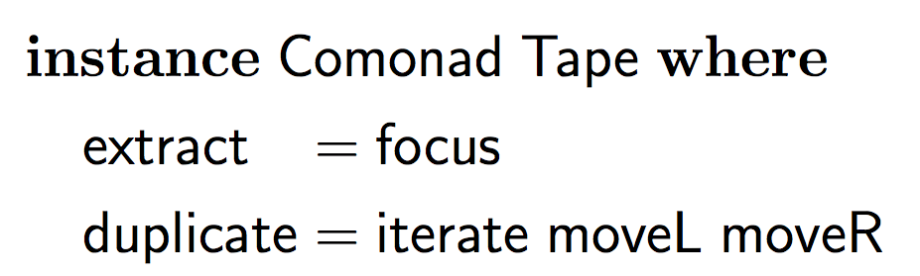
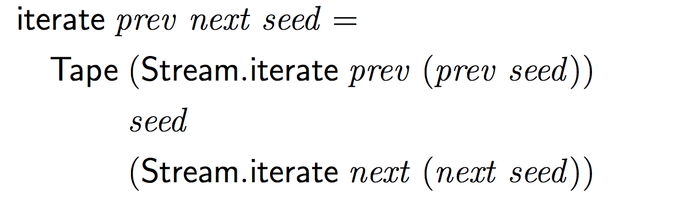
Example: Tape for the ☐
…
…
-3
-2
-1
0
1
2
3
4
Notes:
We can move left and right in a Tape (rope metaphor)
Together with an iteration function for building Tapes…
We can define a comonad instance for them.

Slide 12

Example: Tape for the ☐
…
…
-2
-1
0
0
1
2

Slide 13
Example: Tape for the ☐
5
…
…
…
…
…
…
…
…
…
…
…
4
4
3
3
3
3
3
3
3
3
3
3
2
2
2
2
2
2
2
2
2
2
1
1
1
1
1
1
1
1
1
1
…
…
0
0
…
…
0
0
0
0
0
0
0
0
-1
-1
-1
-1
-1
-1
-1
-1
-1
-1
-2
-2
-2
-2
-2
-2
-2
-2
-2
-2
-3
-3
-3
-3
-3
-3
-3
-3
-3
-3
…
…
…
…
…
…
…
…
…
…
…
…
-4
-4
-5
Notes:
When talking about diagonalization:
NOTE: you can see the original tape in the HORIZONTAL

Slide 14
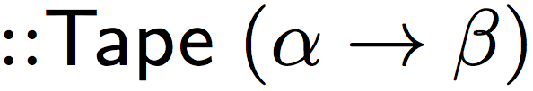
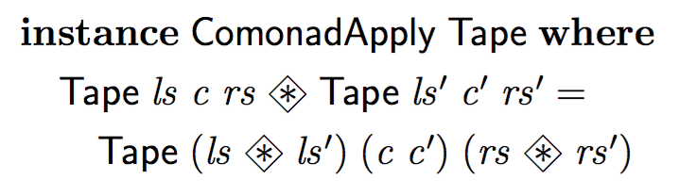

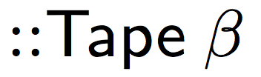

Example: Tape for the ☐
…
f
…
g
h
i
j
…
…
f v
g w
h x
i y
j z
$
$
$
$
$
$
$
$
$
$
…
…
v
w
x
y
z

Slide 15
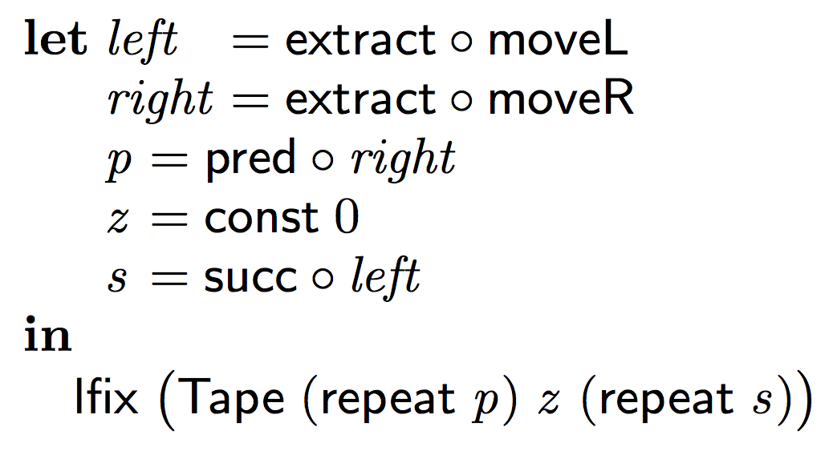
Example: Tape for the ☐
Notes:
Now we can use our intuitions about these parts to build an intuition for how lfix works.
Let’s build an example of a one-dimensional “spreadsheet” with a Tape,
and see how it gets evaluated.
(EXPLAIN CODE)

Slide 16
Example: Tape for the ☐

Slide 17


Example: Tape for the ☐
…
…
p
p
z
s
s
…
$
$
$
$
$
…
$
$
$
$
$
-2
-1
0
1
2
5
…
…
…
…
…
…
…
…
…
…
…
4
4
3
3
3
3
3
3
3
3
3
3
2
2
2
2
2
2
2
2
2
2
1
1
1
1
1
1
1
1
1
1
…
…
0
0
…
…
0
0
0
0
0
0
0
0
-1
-1
-1
-1
-1
-1
-1
-1
-1
-1
-2
-2
-2
-2
-2
-2
-2
-2
-2
-2
-3
-3
-3
-3
-3
-3
-3
-3
-3
-3
…
…
…
…
…
…
…
…
…
…
…
…
-4
-4
-5
Notes:
So, how does lfix evaluate this recurrence?

Slide 18
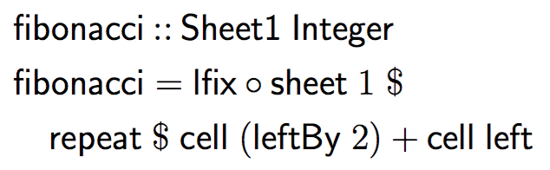
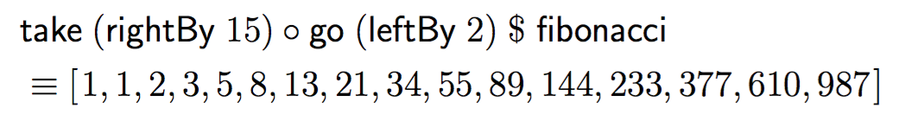
Fibbing again, relatively
Notes:
With a little bit of syntactic sugar…
This is efficient now because of the zipping structure of the lfix combinator.

Slide 19
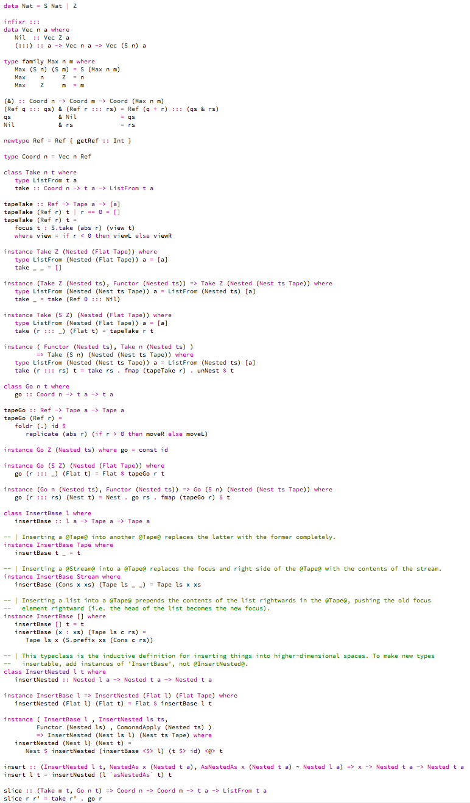
Briefly, some type-hackery. (It’s all in the paper.)
Notes:
Inductive definitions for comonad, comonadapply, and more
Relative references in n dimensions == n-long length-indexed lists of integers
Utility functions for naming directions
Interpret n-D references into movements
Insert possibly-finite fragments of sheets into existing sheets
Details are in the paper (and in the code).

Slide 20
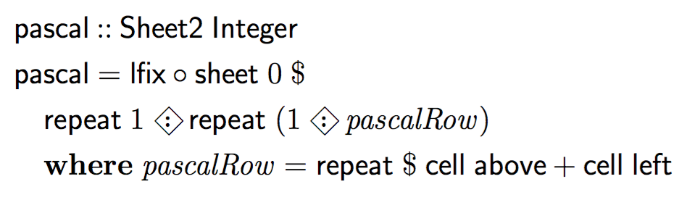
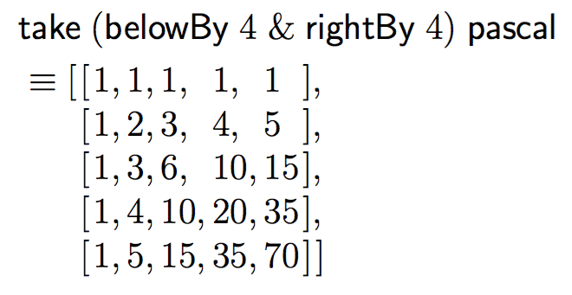
Sweet syntax, savory semantics
Notes:
With that machinery…
Regardless of dimensionality, relative references are O(distance), and we evaluate each cell at most once.

Slide 21
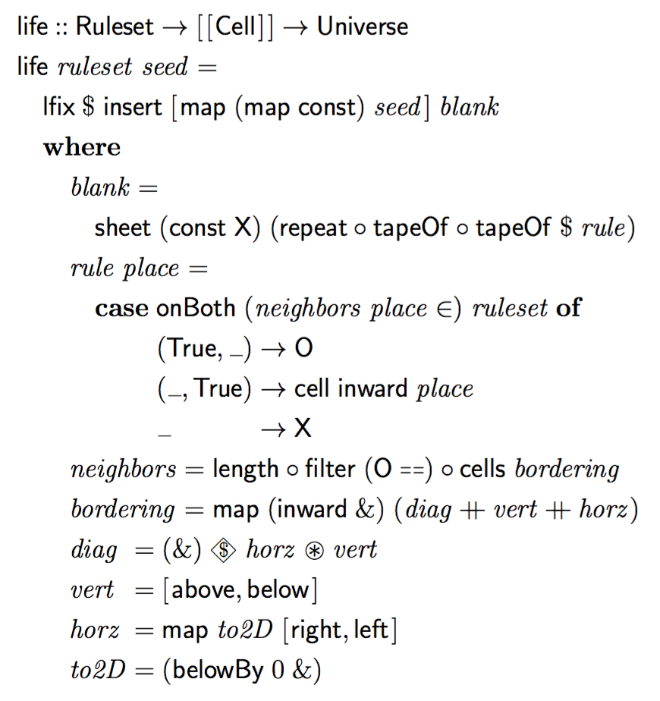



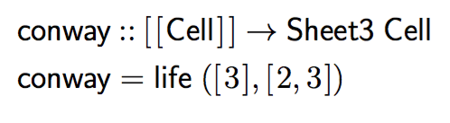
One more thing…

Slide 22
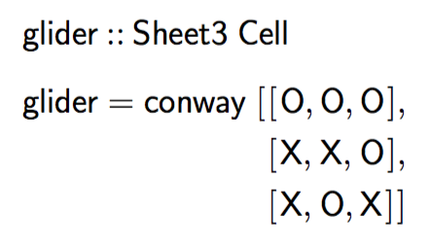
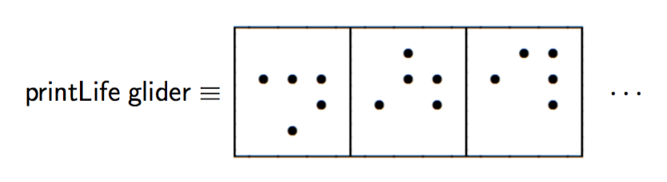
One more thing…

Slide 23
The paper is executable literate Haskell:
github.com/kwf/GQFC

